Slide 1
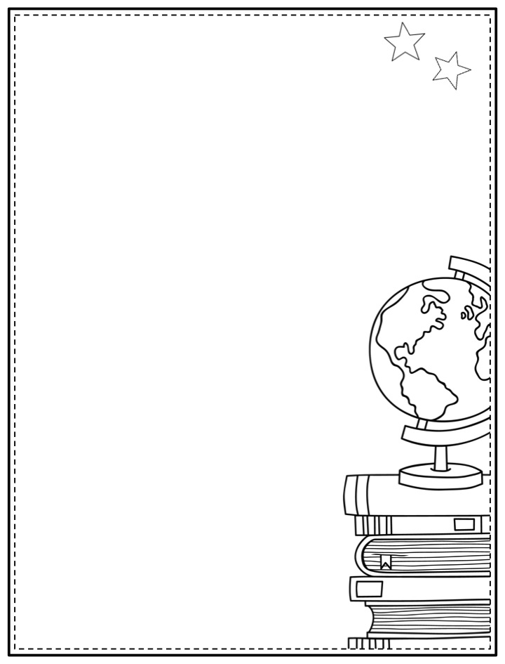
Mrs. White’s
SUPPLY LIST
{2017-2018}
1 box of Cayola Crayons (24 count)
2 Clorox Wipes
3 boxes of Tissues
1-Backpack
1 box of Latex-Free Band-Aids
2- Highlighters (any color)
2 packs of Cayola washable markers (primary colors)
1-roll of paper towels
1 roll of scotch tape
1 shaving cream
1 pack of multicolored construction paper
1 pair of earbuds or headphones for the computer/Ipad
Please do not write your child’s name on any supplies.
All supplies will be shared with the class.
Wish List Items
Cardstock (white or color)
Velcro (sticky back)
File folders
Ziploc bags (snack or sandwich size)
Soft pencil pouches for activity storage
Everything on this list is optional, as the school will always ensure every student has the supplies needed to be successful in school.
We appreciate the support of our families!

